Slide 1
Fasttext Embedding

Slide 2
FastText embeddings
Developed by Facebook's AI Research (FAIR) lab.
Breaks entire words into smaller components called character n-grams.
Capture the semantic meaning of morphologically related words, even for out-of-vocabulary words or rare words.

Slide 3
FastText
Helps with rare words
Handles out-of-vocabulary (OOV) words
Captures morphology (prefix, suffix)

Slide 4
Need for word embedding
Dimensionality Reduction: Represent words in a lower-dimensional continuous vector space, making it computationally efficient to handle extensive vocabularies.
Semantic Similarity: understand synonyms, antonyms, and related meanings.
Contextual Information: help models understand a word's meaning in context, crucial for tasks like sentiment analysis and named entity recognition.
Generalization: generalize well to unseen words, learning from the distributional properties of words in training data.
Feature Representation: Word embeddings serve as feature representations for machine learning models, enabling the application of various techniques to NLP tasks.
Efficient Training: Models trained with word embeddings converge faster and often perform better than those using sparse representations.
Transfer Learning: Pre-trained embeddings, like Word2Vec or GloVe, allow models to leverage knowledge from large corpora, even with limited task-specific data.

Slide 5
FastText embeddings
Utilization of Character-Level Information: capture the internal structure of words, including prefixes, suffixes, and roots, which is particularly beneficial for morphologically rich languages where word formations follow specific rules.
Extension of Word2Vec Model: FastText is an extension of the Word2Vec model, which means inherits the advantages of Word2Vec, such as capturing semantic relationships between words and producing dense vector representations.
Handling Out-of-Vocabulary Words: words that are not present in the training data or vocabulary are also provided embeddings
FastText's Solution for OOV Words: FastText overcomes the limitation of OOV words by providing embeddings for character n-grams.
Improved Vector Representations for Morphologically Rich Languages: not only captures the semantic meaning but also the internal structure and syntactic relations of words, leading to more accurate and contextually rich embeddings.

Slide 6
FastText embeddings
corpus
vocabulary
Sentence 1: data science
Sentence 2: data mining
data, science, mining

Slide 7
FastText embeddings
Choose Character n-grams
Generate n-grams: trigram
FastText usually uses n = 3 to 6.
For simplicity, we use 3-grams (trigrams).
FastText adds boundary symbols < and >.
word: <data>
<da , dat , ata , ta>
word: <science>
<sc , sci , cie , ien , enc , nce , ce>

Slide 8
Assign Vector to Each n-gram
n-gram | Vector
<da | [0.2, 0.1]
dat | [0.3, 0.2]
ata | [0.4, 0.1]
ta> | [0.1, 0.3]
<sc | [0.5, 0.4]
sci | [0.6, 0.3]
cie | [0.4, 0.2]
ien | [0.3, 0.5]
enc | [0.2, 0.4]
nce | [0.3, 0.3]
ce> | [0.4, 0.1]

Slide 9
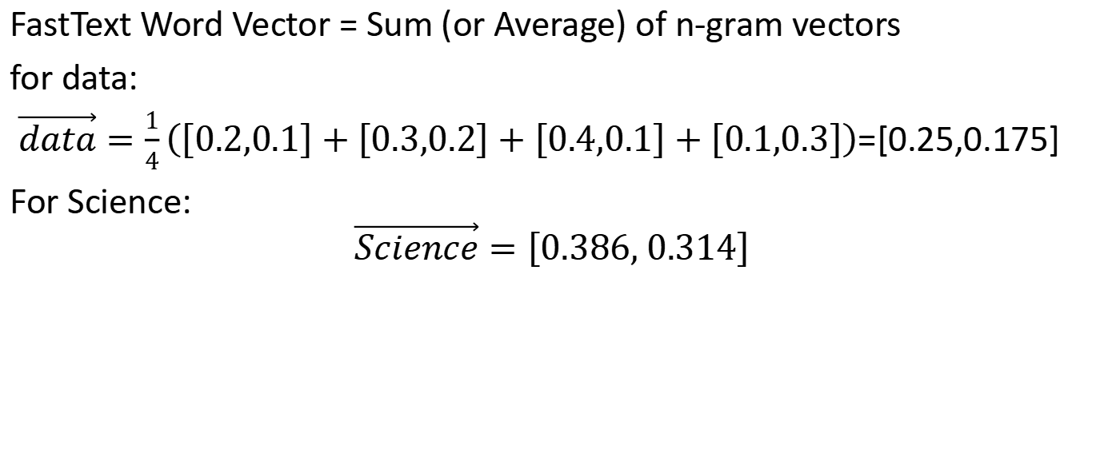
Compute Word Embedding
FastText Word Vector = Sum (or Average) of n-gram vectors
for data:
$\vec{data}=\frac{1}{4}\left(\left[0.2,0.1\right]+\left[0.3,0.2\right]+\left[0.4,0.1\right]+\left[0.1,0.3\right]\right)$=[0.25,0.175]
For Science:
$$\vec{Science}=\left[0.386, 0.314\right]$$

Slide 10
Handling an OOV Word
test word: <scientist>
trigrams: <sci, cie, ien, ent, nti, tis, ist, st>
Since many n-grams (sci, cie, ien) were seen earlier,
FastText computes a meaningful vector instead of UNK.
note: UNK is unknown token

